Slide 1
HTML - semantics
Viktoras Lava www.viktoraslava.lt

Slide 2
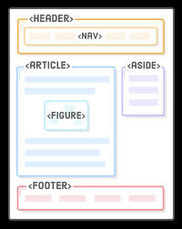
Semantic HTML
Semantic HTML is the use of HTML markup meaning of the information in web pages and web applications rather than merely to define look. Semantic HTML is processed by traditional web browsers as well as by many user agents (robots, machines).

Slide 3
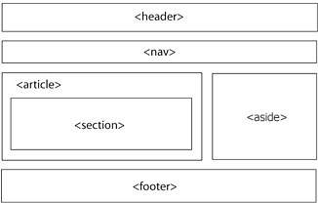
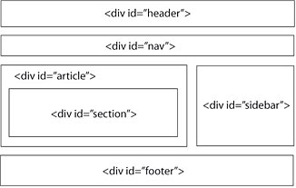
Semantic vs Non-Semantic

Slide 4
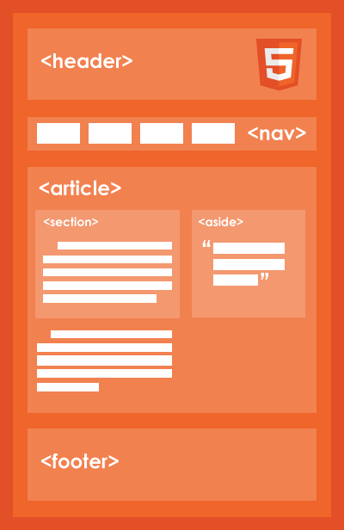
Main semantic tags
main
header
nav
section
article
side
figcaption
figure
footer

